Slide 1

DBMS
PROJECT
Order Management System

Slide 2
KARTHIKEYAN RV CB.EN.U4CSE18331
B KIRTHI SAGAR CB.EN.U4CSE18332
TEAM DROP TABLE
MIGHIL DATH CB.EN.U4CSE18339
TANMAAY KANKARIA CB.EN.U4CSE18362

Slide 3

Project Analysis

Slide 4
Abstract
This Order Management System (OMS) is for a company that sells construction materials.
The company sells multiple products.
We have implemented the OMS as an easy to use website.
Why OMS?

Slide 5
Abstract
Salespersons have their products and customers assigned to them.
Sales department clerks' function is to enter or modify order details and can also view customer information.
Warehouse supervisors maintain the whole inventory and they can also add a new product.
User Types

Slide 6
Abstract
Customer Details
Each customer is assigned at least one address, contact number, and a default salesperson.
Each product has a price, description, and some other characteristics. Orders can also be placed for multiple products at once.
The invoice number of the order is populated automatically in the database and cannot be changed by users. Each order has a status assigned to it. One order can be distributed among multiple shipments, as well as one shipment can contain more than one order.
Product Details
Order Management

Slide 7
User Flow
Login
Salesperson
Department Clerk
Warehouse Supervisor
Inventory
Customer Information
Inventory
Customers
Order Information

Slide 8
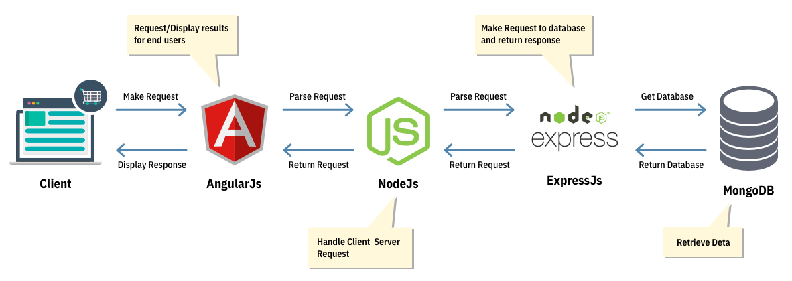


Tech Stack
Client
React
Node JS
Express
PostgreSQL

Slide 9
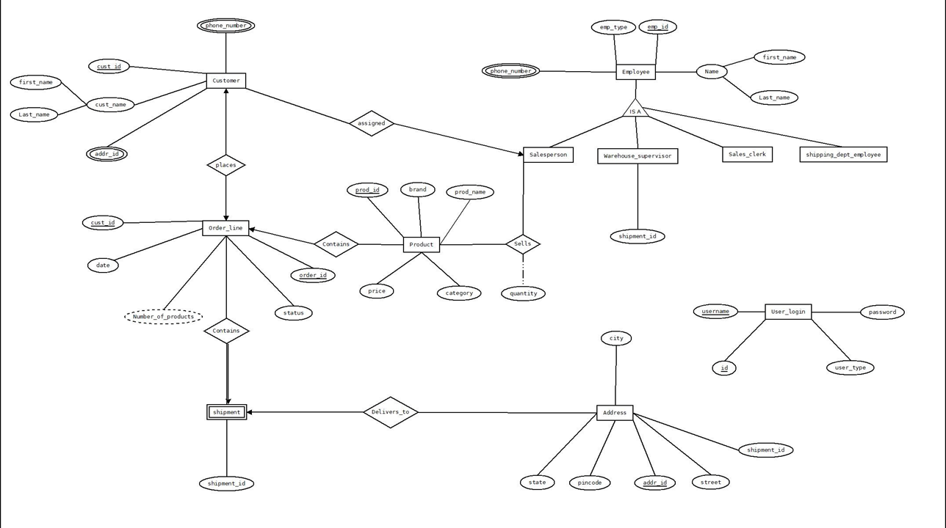
ER Diagram

Slide 10

Demonstration

Slide 11
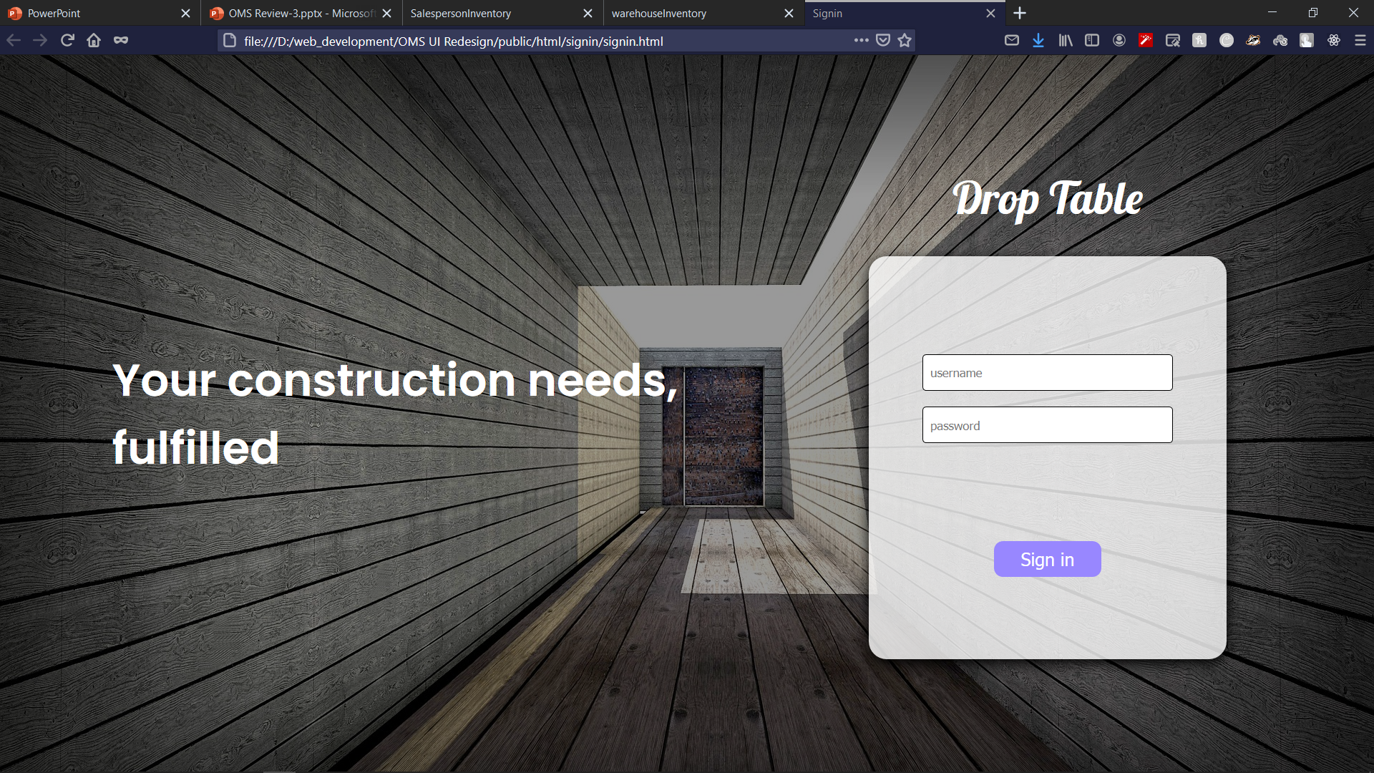

Slide 12


Slide 13
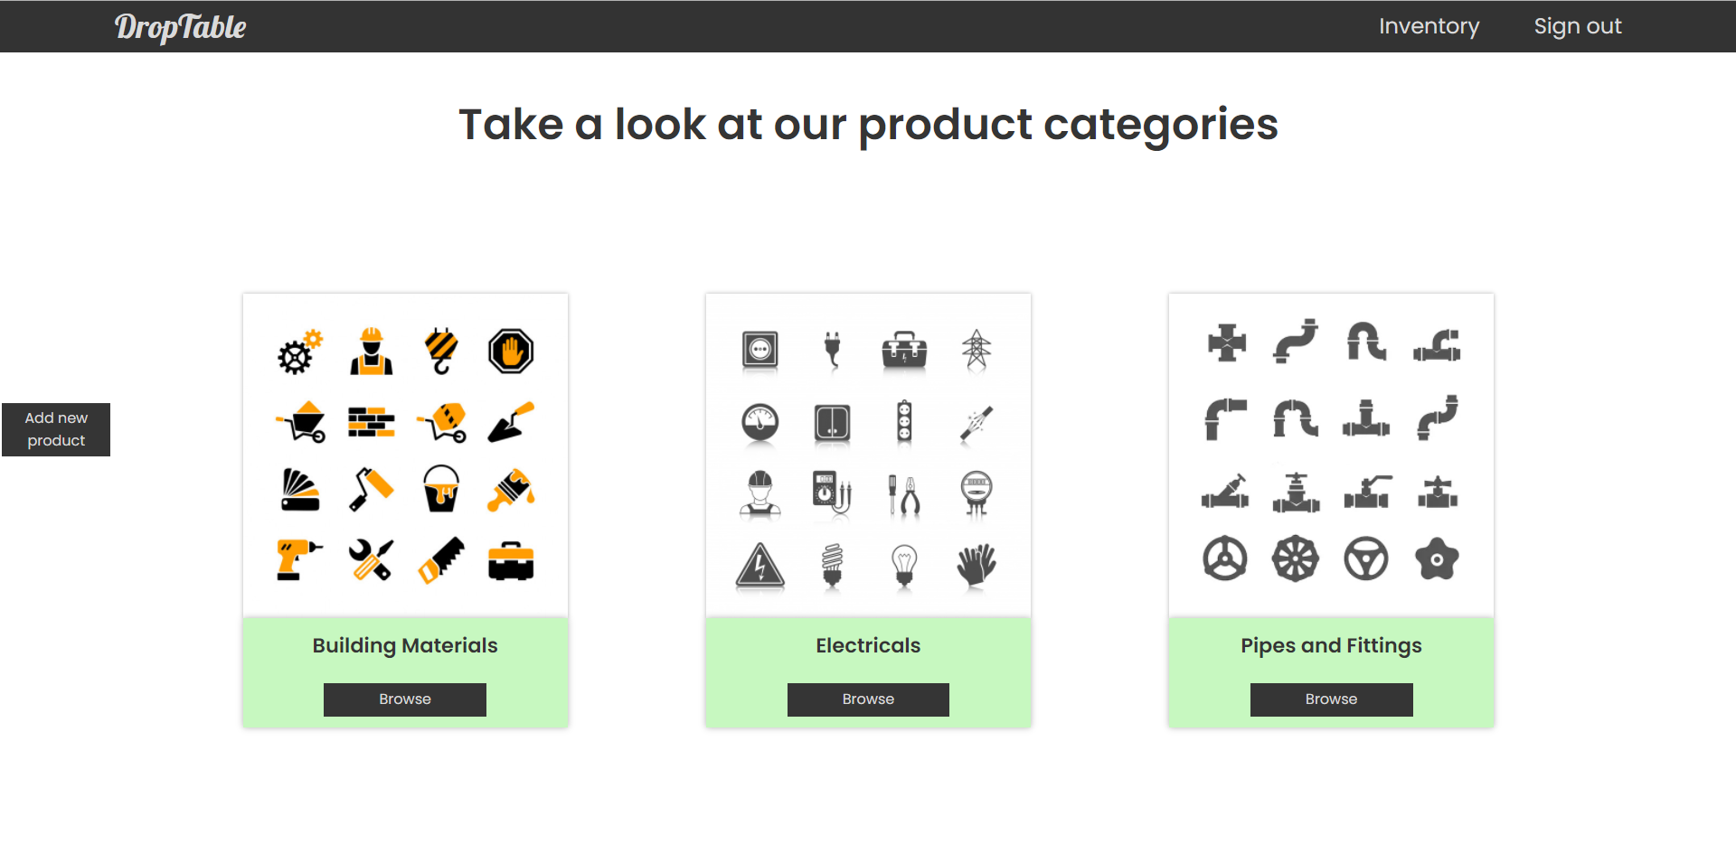

Slide 14
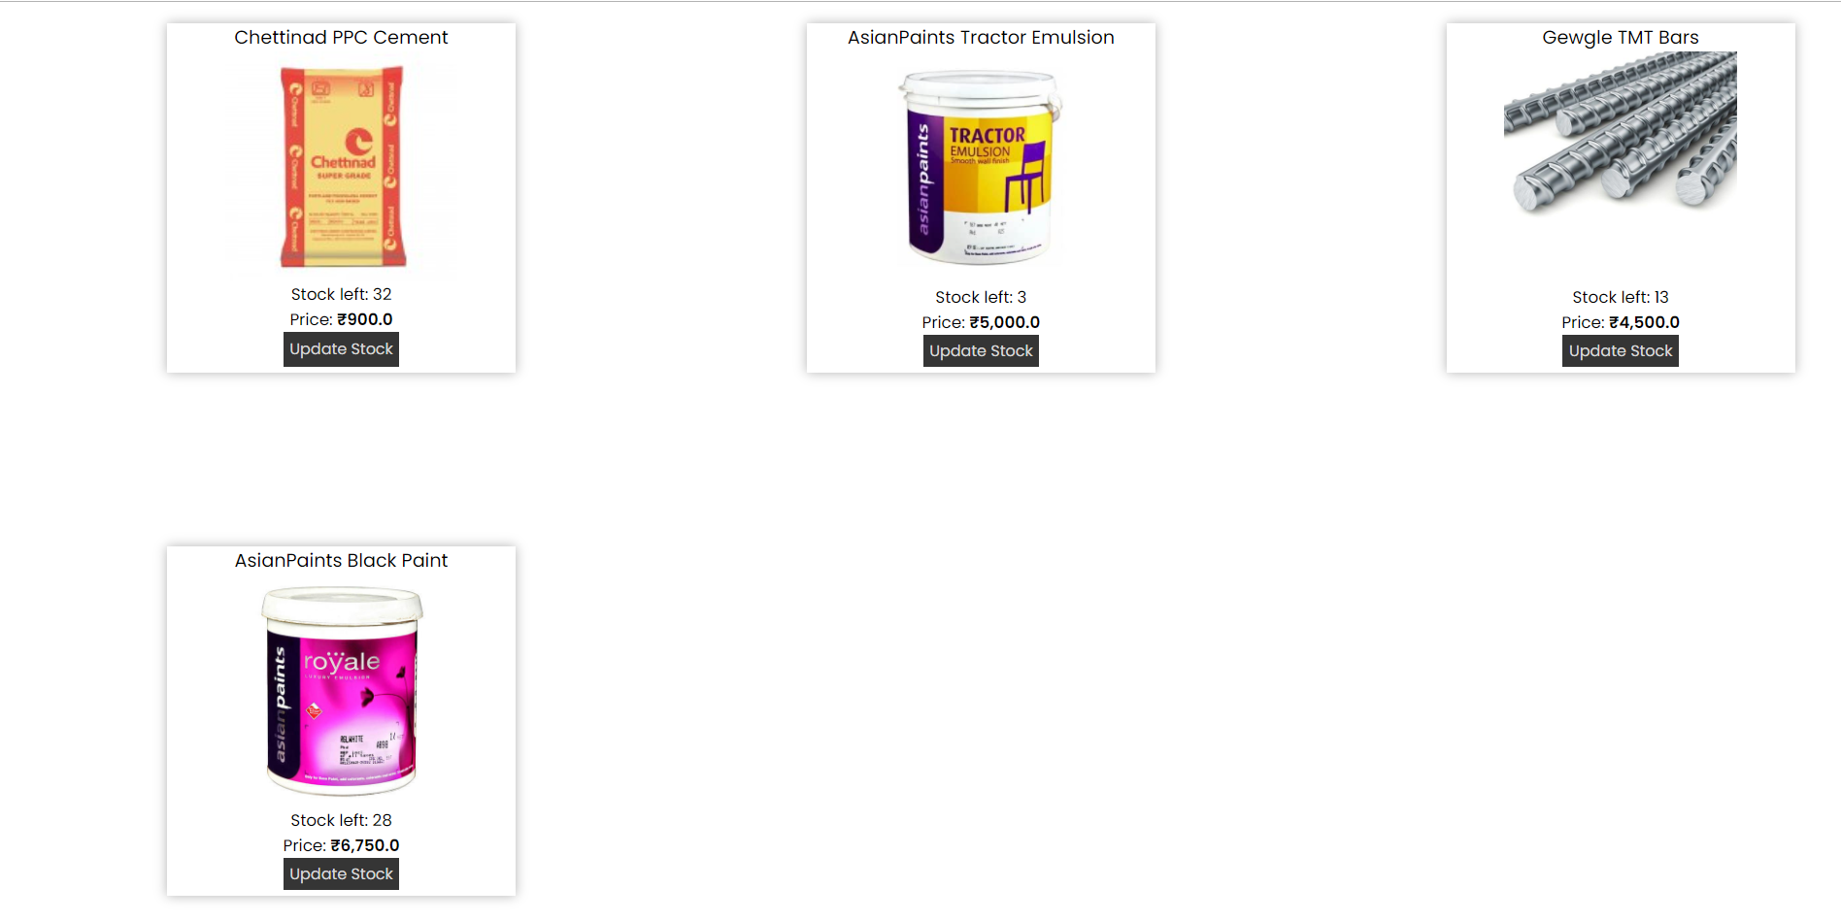

Slide 15
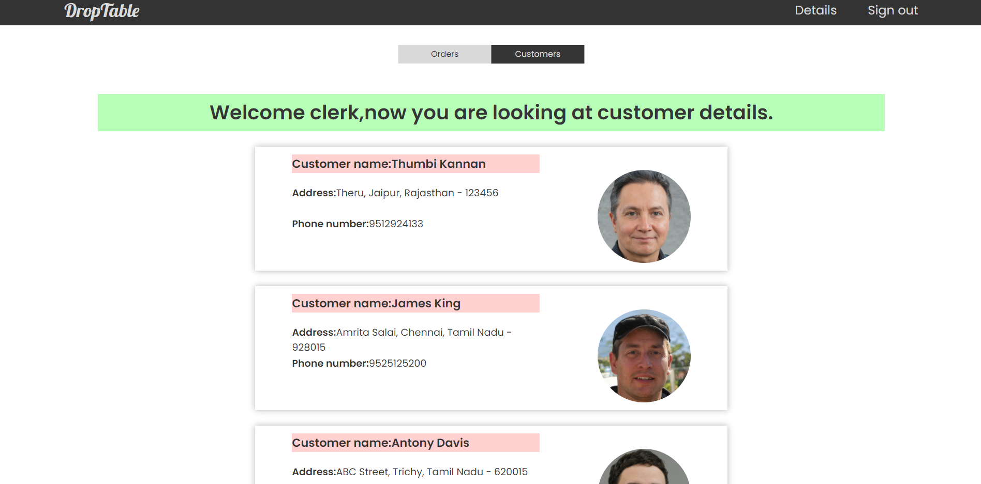

Slide 16



Conclusion
Successfully implemented the following DBMS Concepts
Schema
ER Model
Normalization
DB Connectivity
Full Stack
The full stack process of web development is learned and implemented successfully.
Outcome
Through our Order Management System, a company can manage their products and orders.

Slide 17

Thank you

